Slide 1
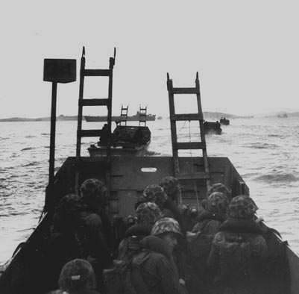
The Korean War:
From the Inchon Landing to the Chosin Reservoir
Keystone Battle Series
Marine Corps History Division

Slide 2
Agenda:
Strategic Context: Why was there a war in Korea?
Invasion and the Defense of the Pusan Perimeter
Counter-attack: The Inchon Landing
The Fight for Seoul
On to North Korea (and to the Chosin Reservoir)
Discussion

Slide 3
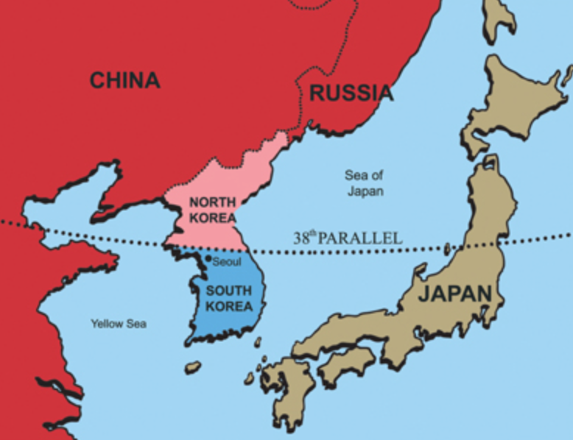
Korea – The Division of a Nation
Korea had been occupied by Japan from 1910-1945
After WWII, the Soviets and Americans agree to divide Korea at the 38th parallel.
The Soviets occupied the North and the U.S. occupied the South.
Koreans on both sides of the border wanted to re-unify the country

Slide 4
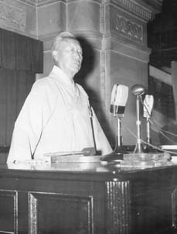
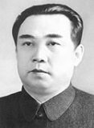
The Roots of War
Both North and South Korea are run by autocrats; neither one is democratic.
North Korea’s leader – Kim il Sung – is the grandfather of the current North Korean leader, Kim Jong Un.
The leader in the South – Syngman Rhee – was pro-US, but was just as autocratic as North Korea. Rhee leaves office in 1960; the South Korea democratizes thereafter.
  South Korean President Rhee
North Korean Premier Kim Il Sung

Slide 5
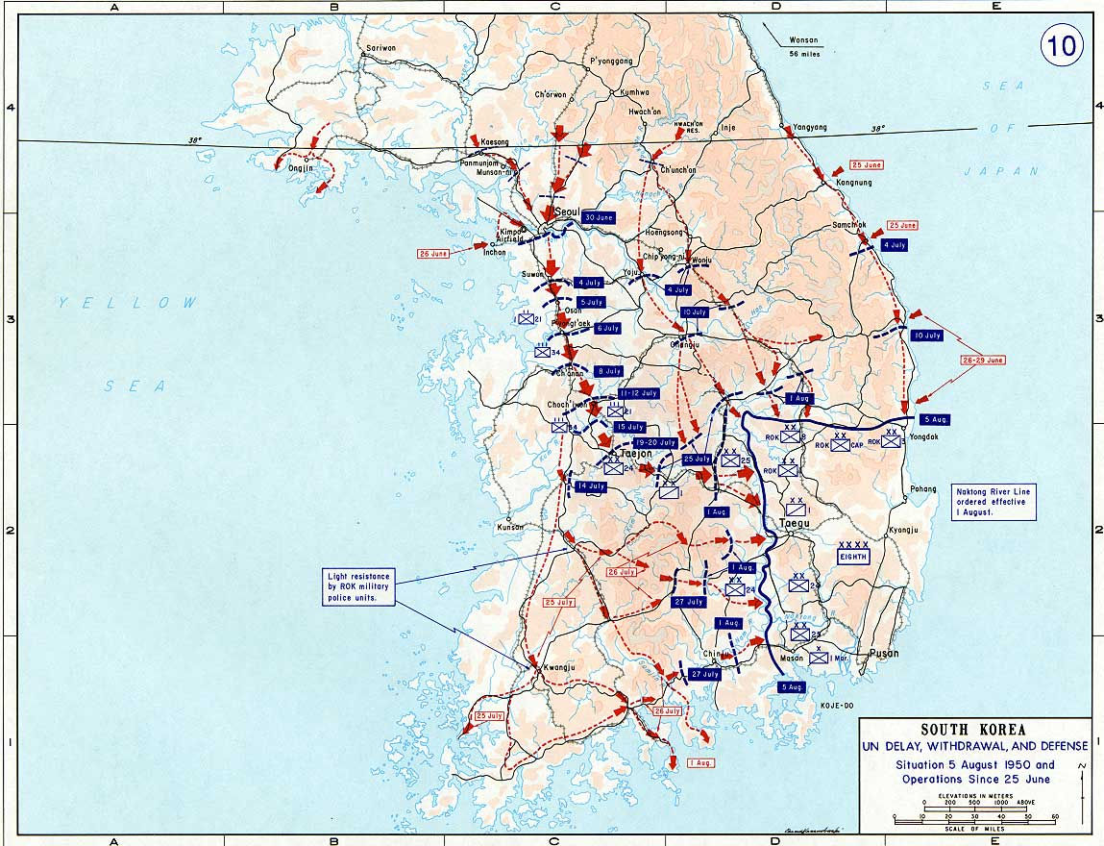
Invasion!
25 June 1950:
North Korea invades South Korea and quickly conquers much of the country.

Slide 6
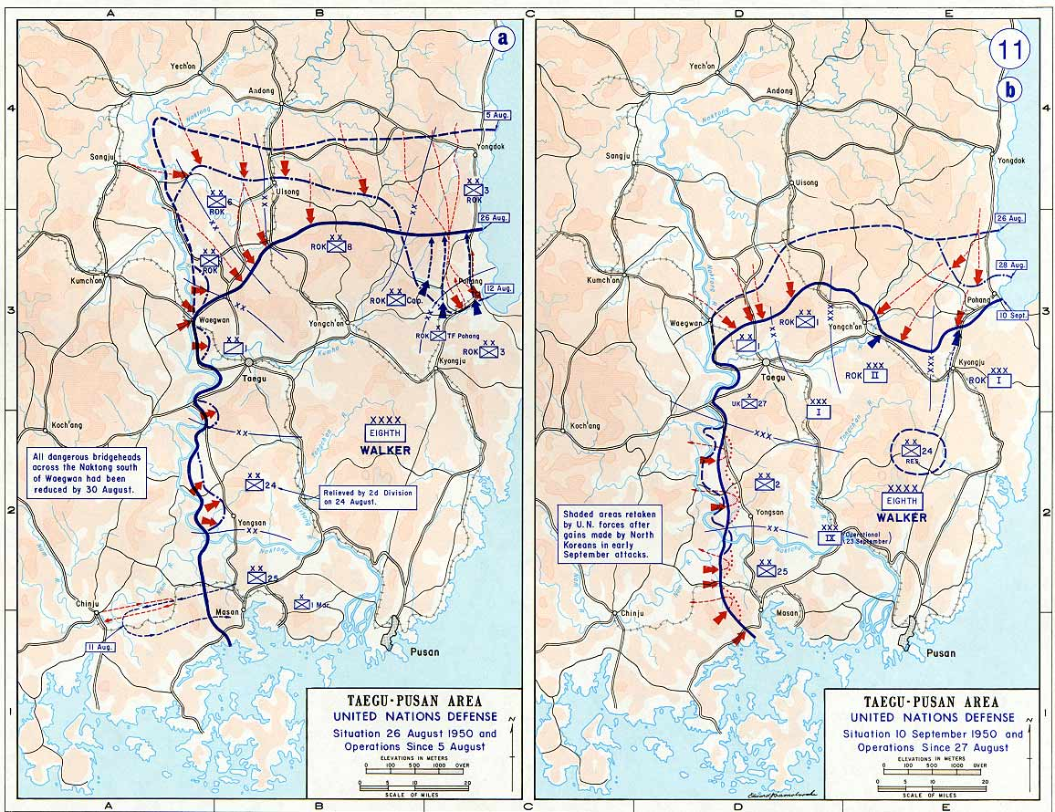
On the Brink of Defeat
By mid-July, all South Korean and US forces are pushed into the southeast corner of the country: The Pusan Perimeter.
The Joint Chiefs of Staff start planning for a total withdrawal from South Korea.

Slide 7
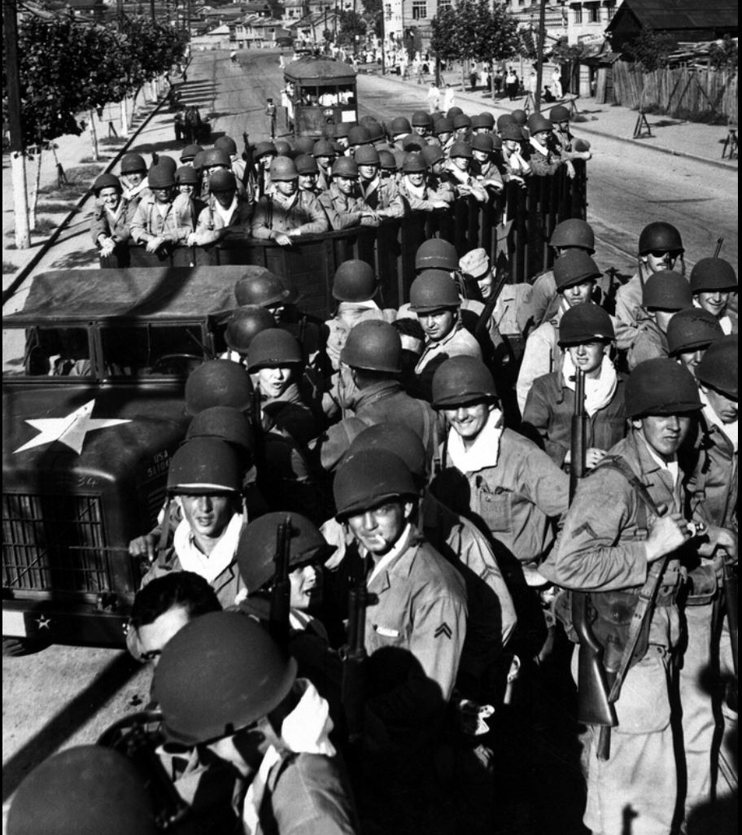
The Marines Arrive!
The 1st Provisional Marine Brigade (“Fire Brigade”) arrived in Korea on 3 August – just 5 weeks after the start of hostilities.
The combination of infantry, close air support, and other support elements were rushed immediately into the fight.
Their arrival helped stabilize the Pusan Perimeter and staved off an imminent defeat.
However, GEN MacArthur still needed to reverse the initiative and liberate South Korea.

Slide 8
MacArthur’s Plan:
Land at Inchon and
surround the North Korean Forces

Slide 9
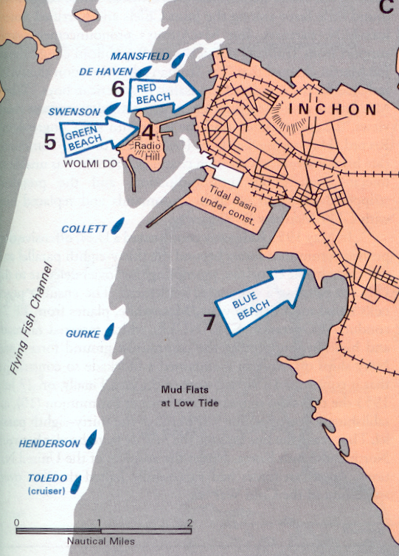
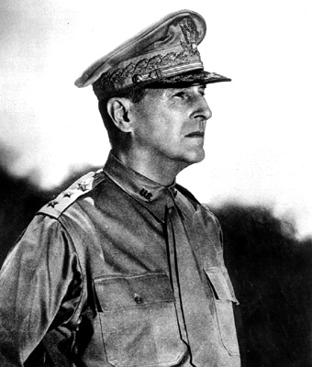
The Inchon Plan
We shall land at Inchon and I shall crush them!
-- GEN Douglas MacArthur,
August 1950

Slide 10
The Interservice Politics of Amphibious Assaults
“An amphibious landing is not a particularly difficult thing . . . You put your men in boats, and as long as you get well-trained crews to take the boats in, it is the simplest deployment in the world – the men can go nowhere else except the beach.”
– General Dwight D. Eisenhower, 1950
“ I am wondering whether we shall ever have another large-scale amphibious operation.”
-- General Omar Bradley, 1949

Slide 11
The Landing
Seize Wolmi Do “Radio Hill”
Secure red beach
Secure blue beach
Consolidate, and continue into Seoul

Slide 12
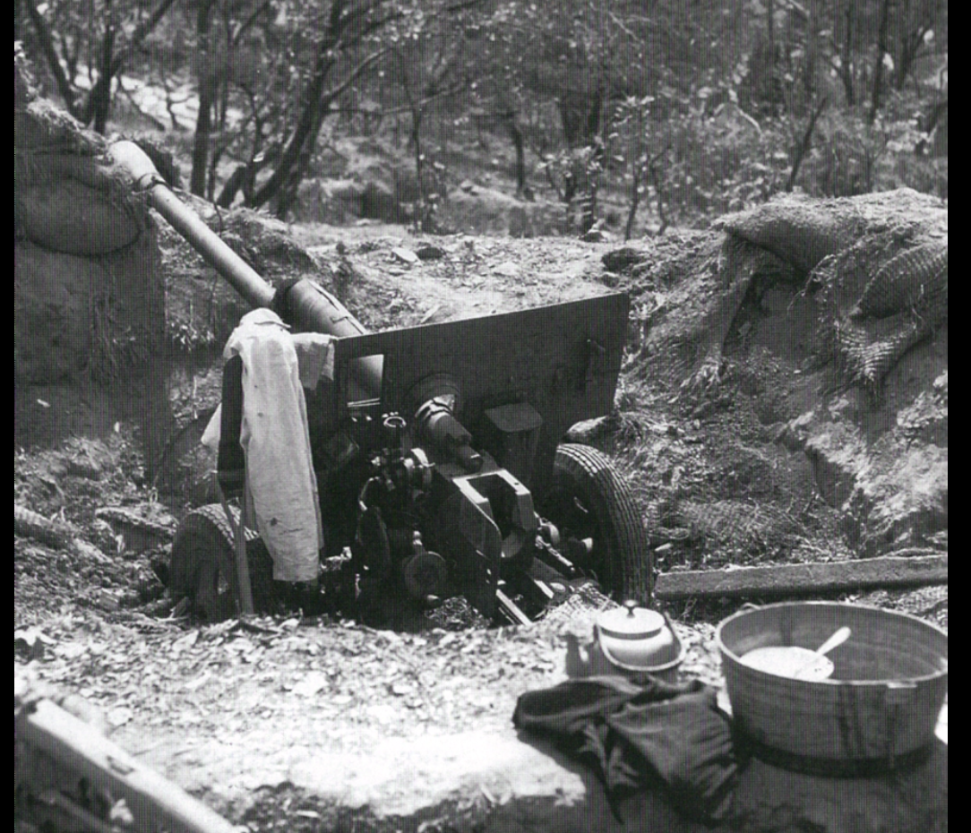
The Inchon Landing
(Operation CHROMITE) 15 SEPT 1950
Marines from the 5th Marines approach the seawall (Blue Beach) and surmount it.
North Korean field gun on Wolmi Do Island (Green Beach)

Slide 13
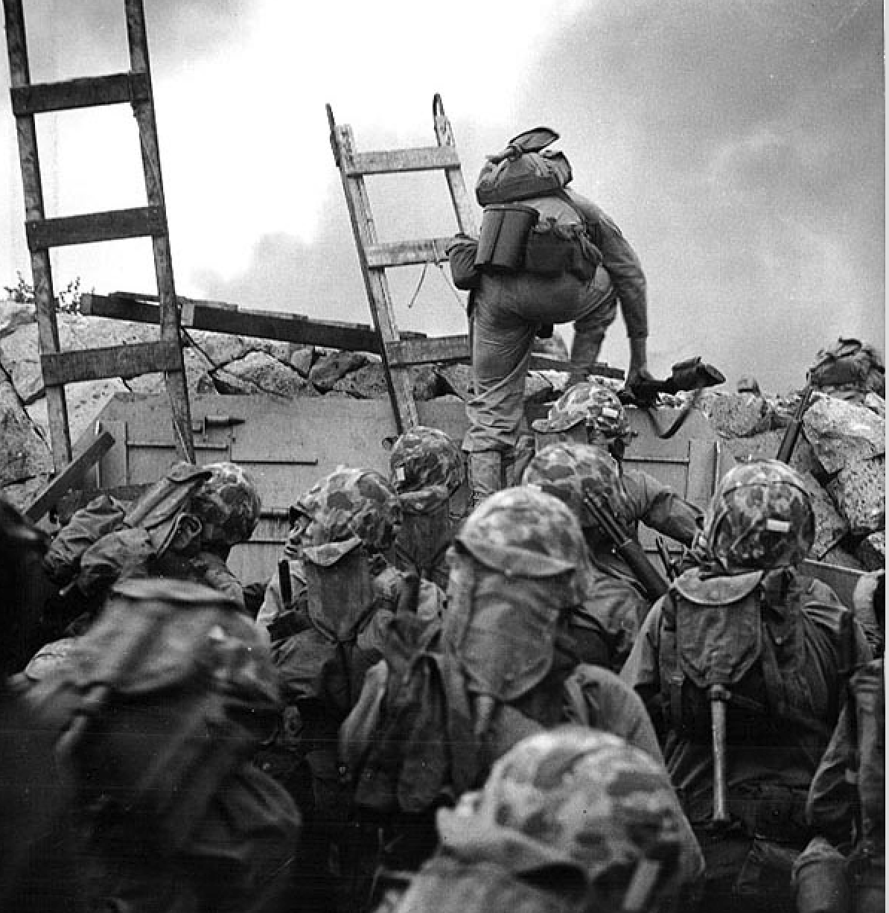
Heroes of Inchon
1stLt Baldomero Lopez (on ladder)
Platoon Commander, Co A, 1st Battalion, 5th Marines
Led his platoon over the seawall
Hit by machine gun fire just as he was preparing to throw a grenade
Pulled the grenade into his body to save his men.
Posthumously awarded the MOH

Slide 14
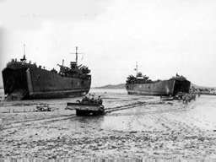
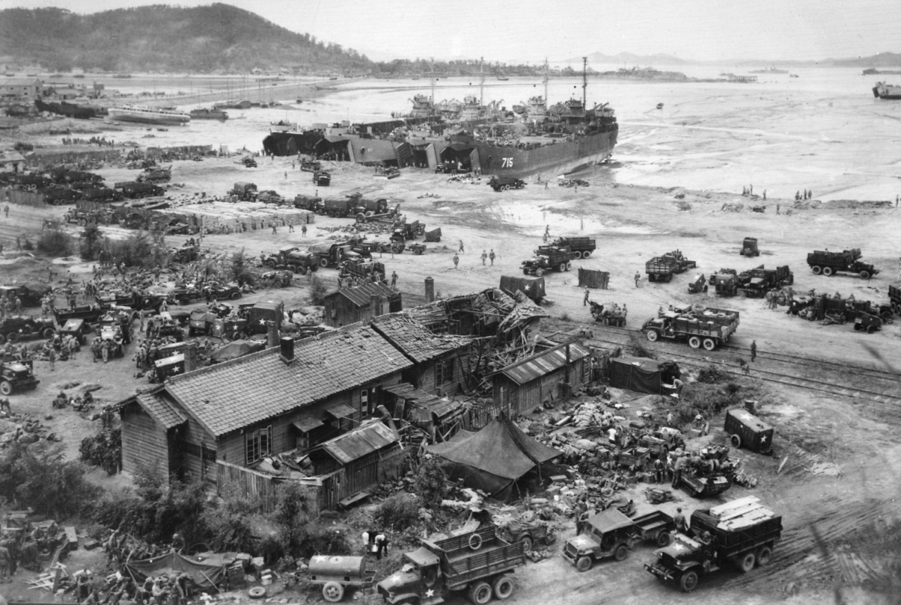
The Mud Flats at Inchon
Low tide:
LSTs stuck in the mud
16 SEPT 1950
Off-loading
The beachhead is secure!
16 SEPT 1950

Slide 15
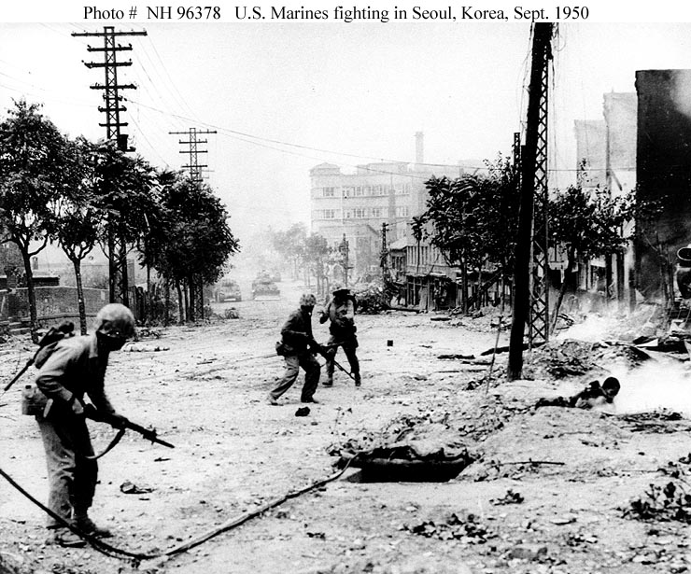
The Fight for Seoul
September 1950

Slide 16
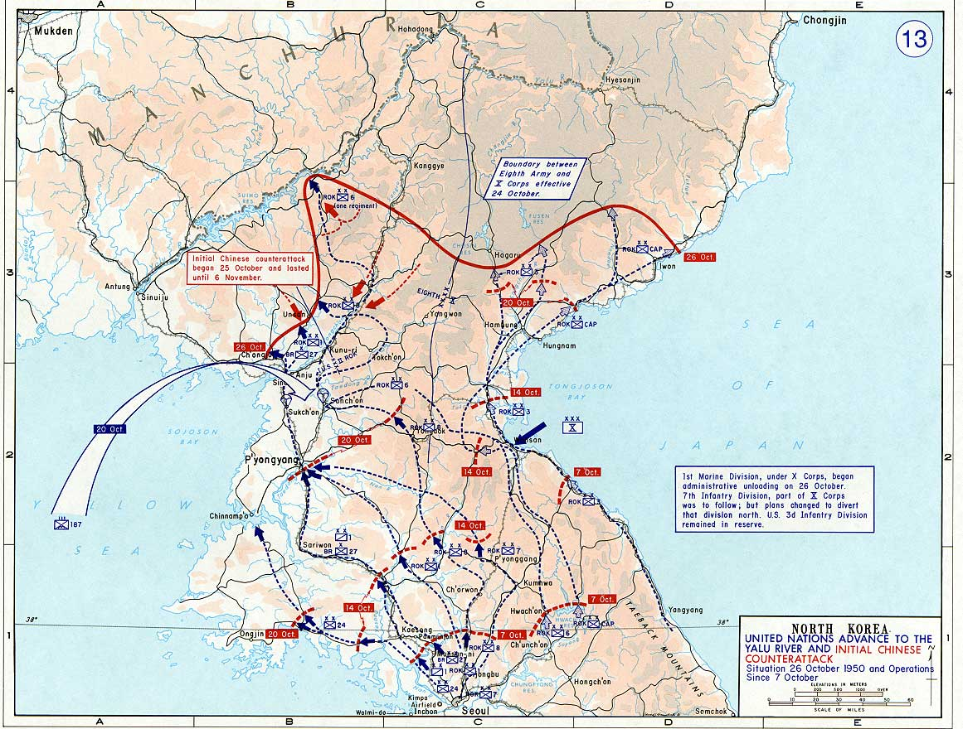
After Seoul: A New Strategic Objective
The Inchon Landing reversed the initiative. Now the US and South Korea went on the attack.
By 15 October the North Koreans had been pushed back across the 38th Parallel.
MacArthur and the JCS had convinced Truman that the North Korean Army had to be destroyed to prevent a renewal of aggression.
Truman changed his objective from defending South Korea to unifying the peninsula.
The Americans crossed into North Korea, determined to overthrow the communist regime in North Korea

Slide 17
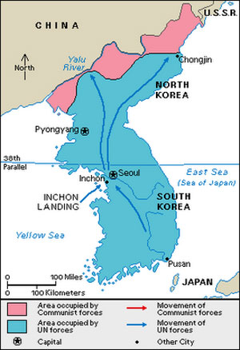
The Chinese Decide to Intervene
The Chinese felt threatened by ‘imperialist’ forces so close to their border.
Chinese leader Mao Zedong was newly in power and had just won the Chinese Civil War a year earlier.
The U.S.’s new goal was to unify Korea, which would deprive China of a security buffer.
On 19 October 1950, the Chinese began crossing the Yalu, massing to attack the arriving 1st Marine Division and the soldiers of the 8th Army

Slide 18
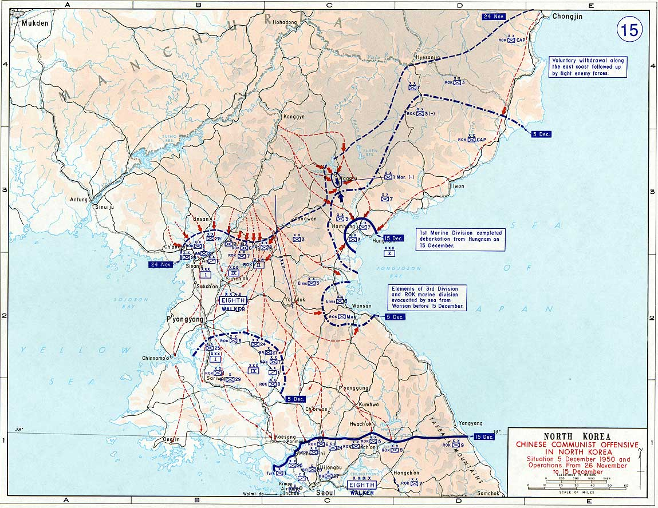
The Chinese Trap
MacArthur was overconfident and vowed the troops would be home by Christmas.
He knew the Chinese were entering the war, but thought it was just a few thousand troops. He was wrong.
The 1st Marine Division advanced to the Chosin Reservoir unaware that 6 Chinese Divisions were already positioned in the hills.

Slide 19
The “Chosin Few” of the Chosin Reservoir
(Changjin)
Temperature: Between 10 and 30 degrees below freezing. Boots, food, water, equipment, medicine and skin all froze in minutes in this severe weather.
Forces: 6 Chinese Divisions against the 1st Marine Division
Terrain: One road in and out with numerous narrow passes and bombed out bridges; the Marines held the road; the Chinese held the high ground.

Slide 20
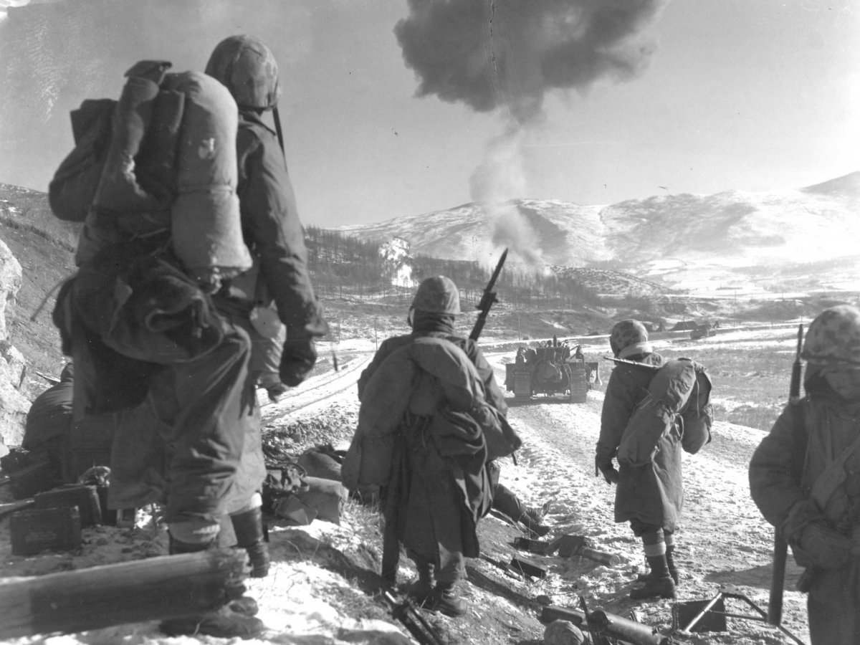
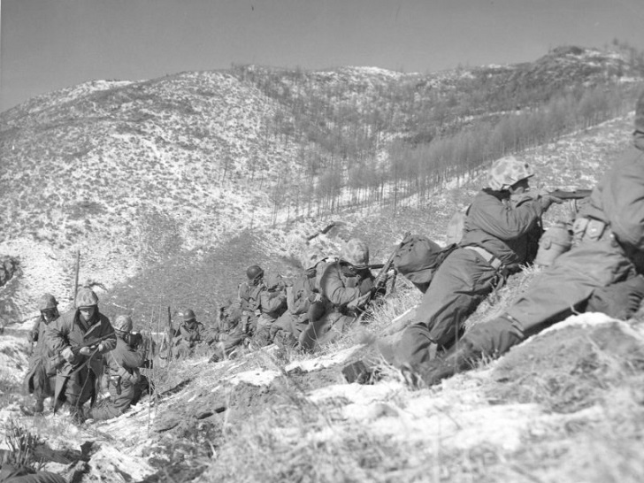
The 1st Marine Division’s Fighting Withdrawal Chosin Reservoir, North Korea, December 1950

Slide 21
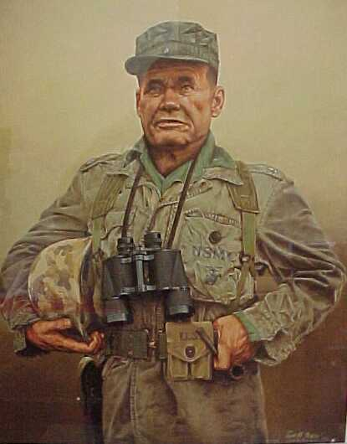
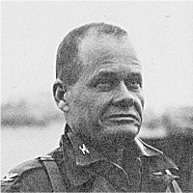
Guts and Determination
“You’re the 1st Marine Division, and don’t you forget it. We’re the greatest military outfit that ever walked on this earth. Not all the Communists in hell can stop you.” - Chesty Puller, 1950

Slide 22
Discussion
Why did the Army think the US would never do another amphibious landing?
What were the risks of landing at Inchon?
What went right at Inchon? What went wrong?
Why were the Marines landing at Inchon in the first place? What was the tactical objective? What was the strategic objective?
What made the fight for Seoul so brutal?
How did the Marines find themselves outnumbered and surrounded at the Chosin Reservoir? What went wrong?

Slide 23
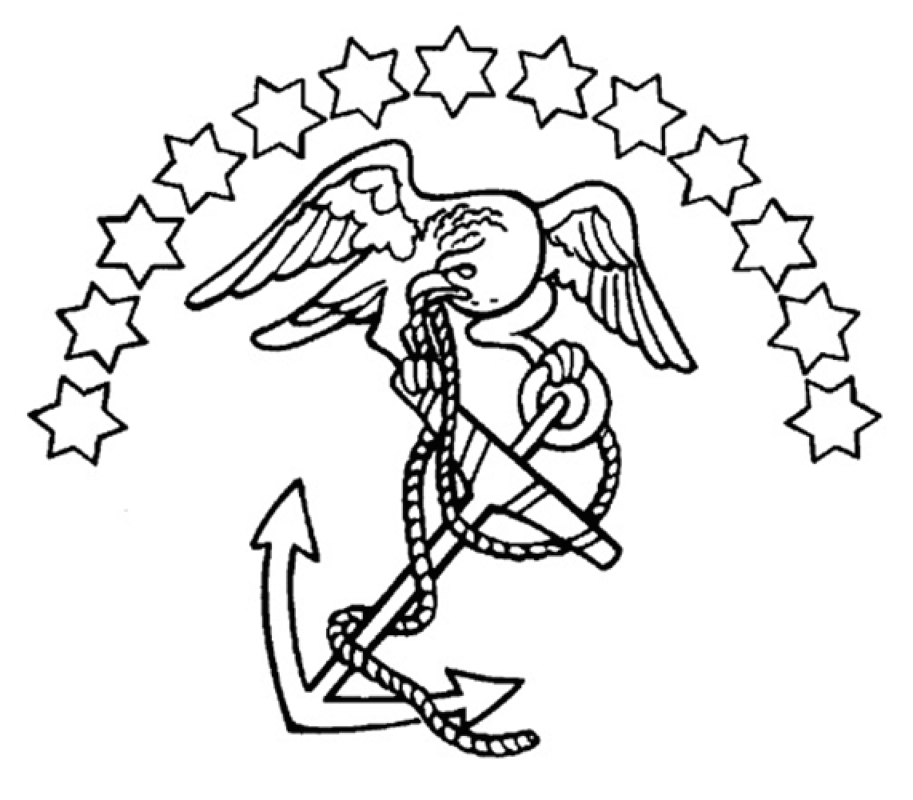
Prepared by:
LtCol Aaron O’Connell, USMCR, PhD
Field History Branch
Marine Corps History Division
www.history.usmc.mil

